Slide 1
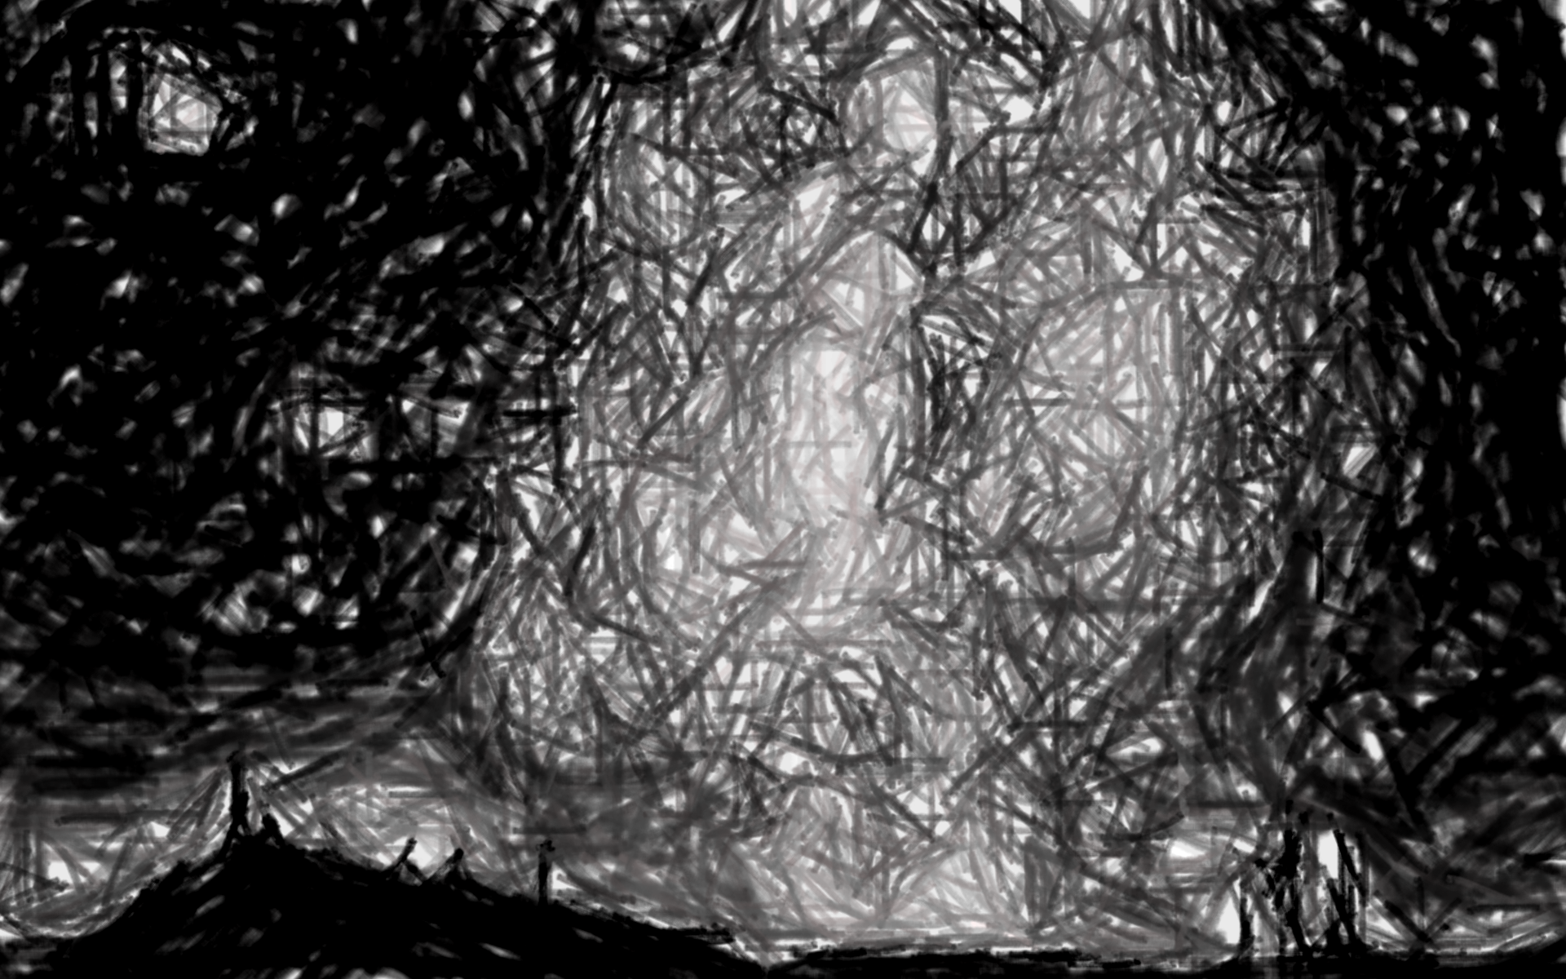
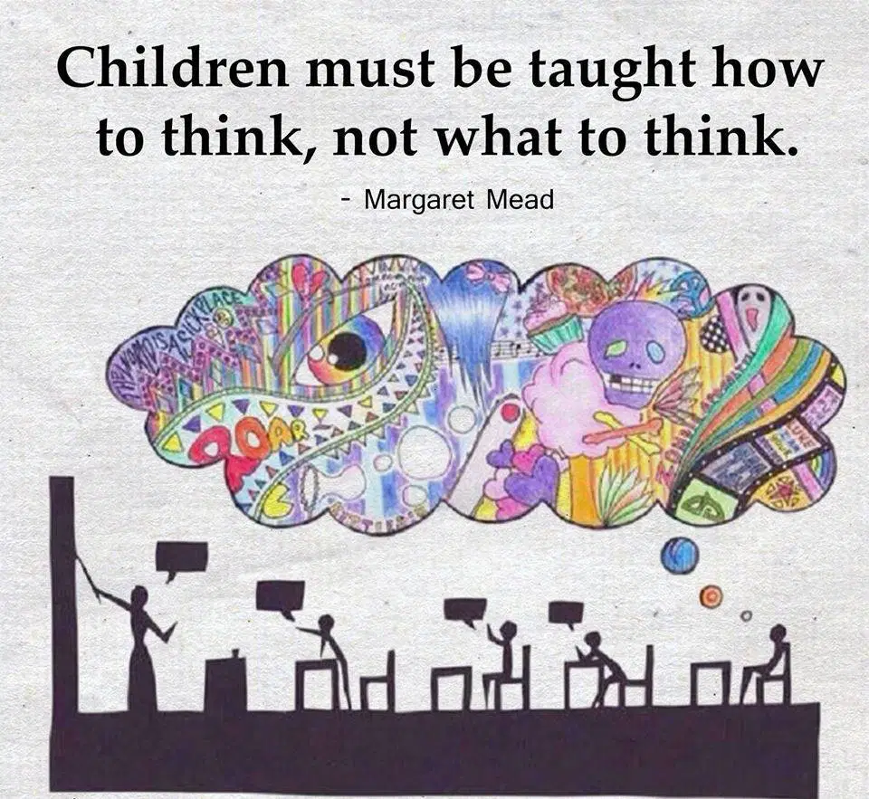

Slide 2

Define EXCEPTIONAL …

Slide 3
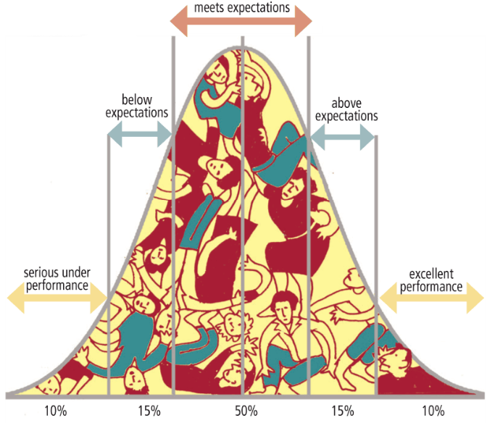

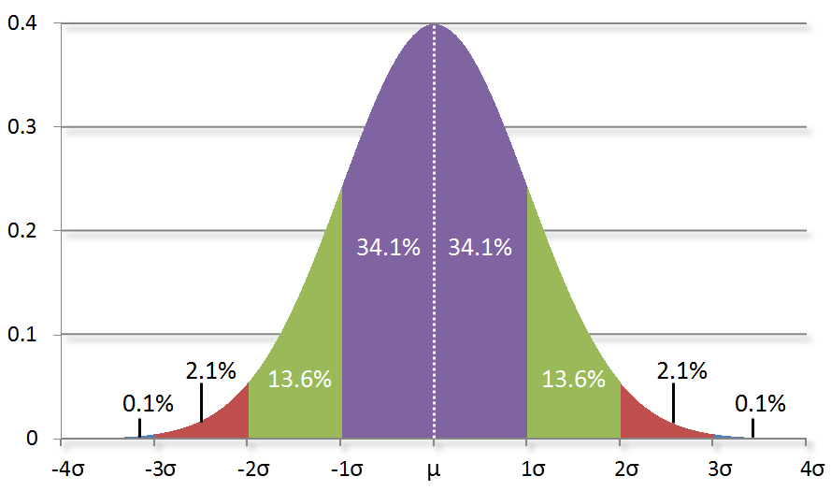
EXCEPTIONAL …
Is an exception to the norm☺

Slide 4
Where, in your life,
are YOU --- EXCEPTIONAL?

Slide 5
Gifted Brains
Living the Non-Neurotypical Life
AHS REACH Gifted Services Presents
- with Mrs. Miller

Slide 6

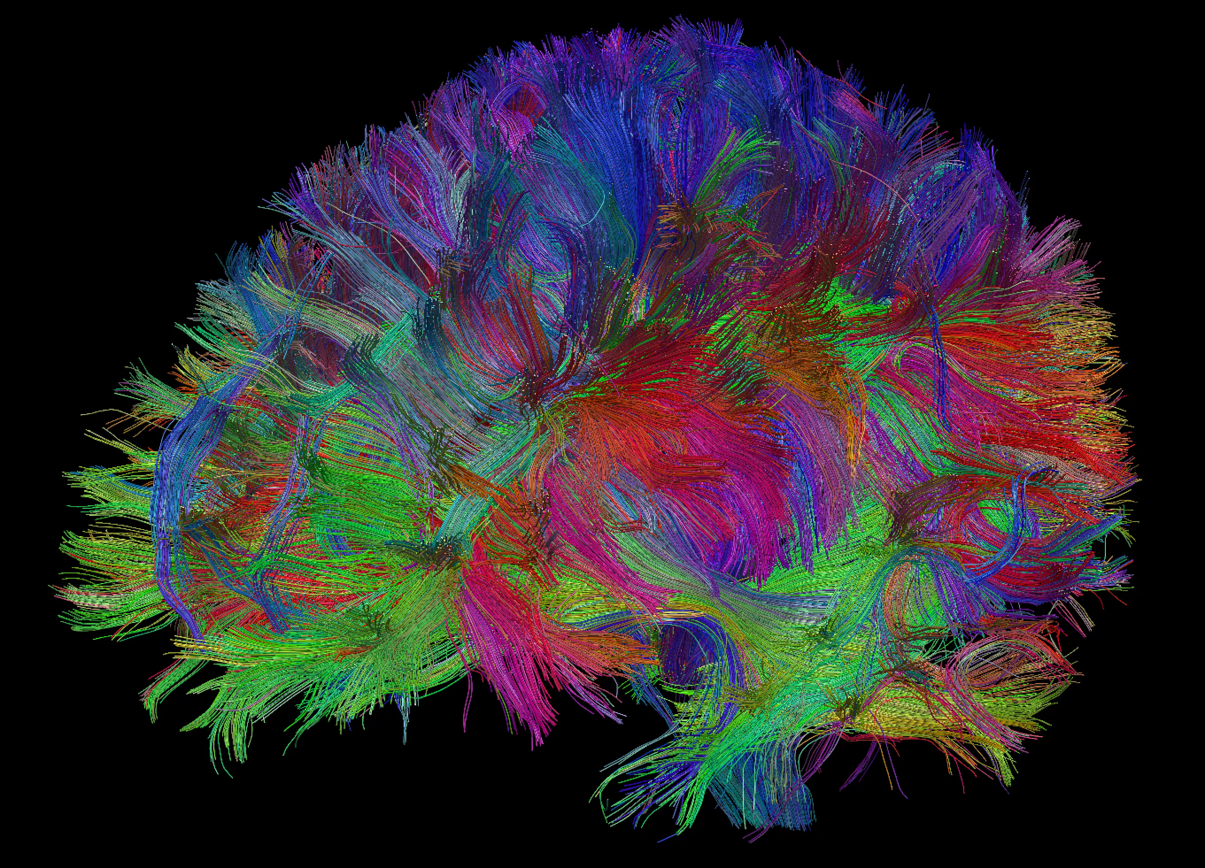
Gifted brains are physically different
More nerve branches that create more synaptic (electrical) connections
More connections mean more paths
to be used for high-level thinking
These paths are also smoother, faster, and more efficient, making them >>> information processing super highways

Slide 7

A supercharged BRAIN wired to:
absorb
perceive
organize
master
synthesize
complex thought & information

Slide 8
PRODUCING:
creative solutions to complex problems
innovative products
visionary insights and perspectives

Slide 9
Understanding Giftedness
Testing Measures
Processing
Exceptional Aptitudes
97+ percentile
Verbal Reasoning
Quantitative Reasoning
Spatial Reasoning
Average learner needs 8-10 repetitions to master content
Gifted learner (in the ZONE) needs ½ - 1 repletion to master content
Gifted learner needs complexity, novelty, depth and acceleration to stay in the LEARNING ZONE
Pattern & series recognition
Critical thinking
Creative problem-solving
Heightened self-awareness
Elevated empathy
Elevated existential perspectives
Scientific & artistic exploration
Rapid language acquisition
Applied & theoretical math concepts
Heightened perceptions of social justice & human systems
Heightened perceptions of natural order & cosmic systems

Slide 10
However, even in a supercharged system:
Gifted (exceptional) pathways rarely occur throughout the entire brain
No one is entirely “gifted” – not even Shakespeare …
It’s possible to grow new pathways throughout the brain
Unused connections wither and die – especially at young ages because they are newer and less sturdy
Early Intervention – support and understanding – CRITICAL☺

Slide 11
A supercharged brain is exceptionally INTENSE
Over-excitability (OE) means to be unusually sensitive, aware, and intense.
OE categories: psychomotor, sensual, intellectual, imaginational, and emotional
See handout

Slide 12
Psychomotor OE
Awesome☺
Awful☹
Physical activity and liveliness
Love of movement
Fast-twitch muscle precision
Agility, fast reflexes, coordination
Boundless energy
Rapid speech
Zealous enthusiasm & charisma
Physical presence
Intense drive, competitiveness
MUST MOVE
Nervous habits (picking, fiddling, tapping, humming, etc…)
Compulsive chatter
Overly competitive
Does not always recognize boundaries – NEEDS to test them

Slide 13
Sensual OE
Awesome☺
Awful☹
Intense sensory awareness of surroundings, nature, simple human experiences
Elevated sensory integration (i.e. sight, smell, touch, sounds, tastes)
Appreciation for physical comforts, delicacies, beauty, aesthetics
Music, art, literature, fashion, design, culinary, NATURE, etc…
Agitated by certain sensory inputs
Light-levels, clothing tags, tight clothes, loose clothes, food textures, smells, sounds, personal space
Very specific preferences and irritants
Can be moved to tears or intense emotions for beauty or ruin
The mundane is distasteful and boring

Slide 14
Intellectual OE
Awesome☺
Awful☹
Avid reader, learner & explorer
Keen observer of details & nuances
Tenacious problem-solver
Active, curious mind
Intense concentration for sustained periods of time
Exceptional memory
Theoretical, philosophical
Elevated sense of social justice, ethics and morality, “big picture”
Needs to be “right” (all the time)
Can become cynical, critical, aloof
Impatient with “slower” minds
Intensely agitated by adult and worldly issues beyond their control
Avoids group efforts, teams – independent to a fault

Slide 15
Imaginational OE
Awesome☺
Awful☹
Intense imagination
Elaborate and vivid dreaming, waking and slumbering
Can recall vivid details from dreams
Thinks narratively, figuratively
Communicates in metaphors, symbols, allegories - complexities
Perceives multiple dimensions
Invents worlds through detailed visualization
Perceives beauty in unusual places
Easily distracted by internal tangents
Confuses reality with fantasy
Agitated by rules and confinement, schedules and routines
Would rather dwell in stories, art, film, music, dreaming, etc… than mundane experiences (e.g. school, daily tasks, chores, events)
The real world PALES in comparison to their imaginal world

Slide 16
Emotional OE
Awesome☺
Awful☹
Elevated empathy
Perceives a wide range of emotions
Discerns complex and distinctive emotions
Forms authentic relationships
Capacity for kindness and compassion
Possess a rare sense of SELF – like an open book, authentic, transparent
Worries about other people
Worries what other people feel about them
Worries about disappointing others
Worries about loss of relationships and connections
Can be “too open” --- TMI
Can lose sense of self in others --- boundary issues
Prone to intense (dark) emotions >>> sadness, grief, despair, depression, dissociated-from-body experiences …

Slide 17

There. Is. No. Off-switch.

Slide 18
Is the term ‘gifted’ an enigma? A stigma?
Gifted is not simply ‘smarter’
Gifted brains are EXCEPTIONAL, with exceptions to the norms in terms of how they learn and grow
Being EXCEPTIONAL can be overwhelming, exhausting and stressful
There is no “OFF-SWITCH”
Traditional methods and environments can frustrate and alienate gifted learners
The gap between the exceptional and other parts of the gifted brain is problematic … and quirky …
Unchecked, these issues lead to UNDERACHIEVEMENT and social-emotional struggles

Slide 19
Easy-to-See Exceptional …
High Achievers:
Gifted Learners:
Know the right answers
Work hard to achieve
Learn difficult material with guidance, practice, and repetition
Like & work well with structure in school
Productive and energized by group work
Have active imaginations
Motivated extrinsically by grades, recognition, and approval
Get it intuitively and want to know “why?”
Absorb knowledge without working hard
Learn difficult material rapidly, without much effort or help
Prefer self-directed learning
Find group work distracting or slow
Use imagination to experiment and create
Intrinsically motivated by the search for meaning and passion

Slide 20

When TALENT isn’t enough…
*52% of gifted students will become UNDERACHIEVERS at some point…
Lack of academic survival skills – time management, organization, routines, coping with setbacks and failures
COAST in elementary – TANK in secondary
Low learning motivation, boredom, apathy
Anxiety, perfectionism, depression
Existential depression
Undiagnosed learning/social-emotional disabilities
Inability to focus, engage and complete tasks
Social-emotional struggles
Lack of support, peers, mentors and advocates
Unstable family life *2019

Slide 21
Unraveling the ENIGMA …
ASYNCHROUS DEVELOPMENT
The EXCEPTIONAL brain grows through developmental windows ASYNCHRONOUSLY – or, OUT OF SYNC with peers
Walking, maybe even running, and - NEVER CRAWLING
Speaking in paragraphs and skipping ‘baby babble’
Reading independently and skipping reading mechanics
Difficulty with: holding a cup, tying shoes, riding a bike, swimming … using folders and planners … sorting and organizing belongings --- MESSY ROOMS
More comfortable with older children and adults than peers
Understanding very mature issues at a very young age
Exceptional children learn to HIDE their exceptions at exceptionally young ages --- (hyper self-conscious, anxiety, ….)

Slide 22
Unraveling the ENIGMA …
TWICE EXCEPTIONAL (2E)*
Learning disabilities
Physical disabilities
Health issues
Social-emotional, mental health issues
Est. 6% of the general population *(2019)
Highly imaginative, perceptive and/or intellectual human beings
Student can have more than 1 disability
Disability tends to overshadow giftedness
Meltdowns at school and home
Avoidance behaviors
Oppositional behaviors
Extreme preferences and interests
Needs more than 1 kind of learning environment and instructional support

Slide 23
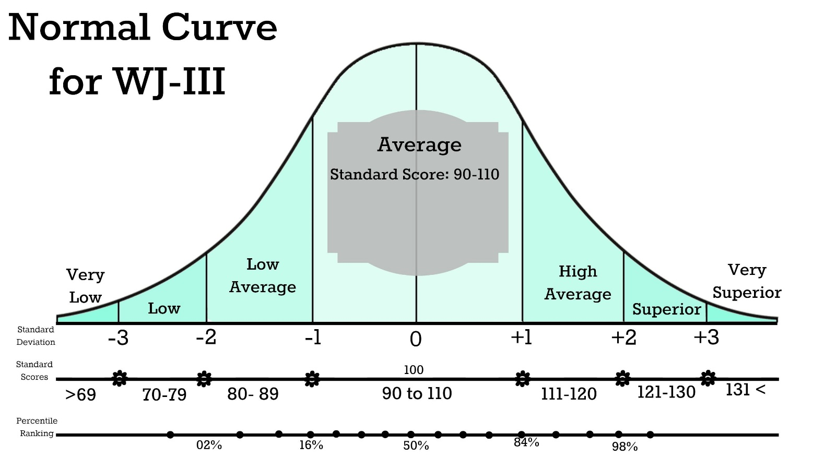

Unraveling the ENIGMA …
TWICE EXCEPTIONAL (2E)*
Verbal, Visual & Quantitative Reasoning
Visual Discrimination
Inductive and Deductive Reasoning
Short-term, Long-term, Sequential, Non-sequential Memory

Slide 24
Unraveling the ENIGMA …
Twice Exceptional (2E)*
Unraveling the ENIGMA …
“Gifted” means to be an EXCEPTION …
To learn to live with EXCEPTIONS …
And, hopefully,
find ways to live an EXCEPTIONAL life☺
Meltdowns
Extreme preferences
Avoidance
Social-emotional struggles
Parents, family, teachers become frustrated, impatient
Learning disability (or more than one)
Social-emotional
Physical
*Estimated 6% of population, 2019

Slide 25

Cultivating the exception into a gift…
intervention & support
Early identification (grades 2-3)
Early intervention
Supportive learning environments
Motivational tools
Self-regulation
Executive skills
Goal-setting
Growth mindset
Peer groups
Mentors, advocates and support systems
Family support & validation
ADVOCACY at all levels
Pre-school > play-based, social-emotional
Elementary > identification, clusters/differentiation, pull-out
Middle School > humanities/STEM cohorts, advanced math/science, accelerated math/science
High School > push-in, mentors, AP, JTED, CTE, beyond-the classroom opportunities

Slide 26
Cultivating the exception into a gift…
intervention & support
Affirmation
Advocates foster self-regulation, task management skills, executive functioning
Perspective
Advocates foster a Growth Mindset
Risk-taking
Permission to explore parts of self that are not exceptional and enjoy them
Self-care
Raising self-awareness, meditation, connection, “getting out of the head and back into the body…”
Love
Every child deserves to be loved and cherished for who they are --- PERIOD.
Helplessness and being misunderstood
Feeling inadequate and incapable
Feeling “out of control”
Perfectionism >>> irrationally high expectations
Tunnel vision
Never enough
Indifference and apathy
Defensiveness
Imposter Syndrome, “I’m fine.”
Fear and shame

Slide 27

Legally Speaking…
ARS Ch. 7, Article 4.1, 15.779
State-Mandated Gifted Education Requirements
1. “Academic courses and services must provide an educational program that is an integral part of the regular school day and that is commensurate with the academic abilities and potential of a gifted pupil.”
2. A “gifted pupil" is a child, who due to superior intellect or advanced learning ability, or both, is not afforded an opportunity to progress and develop in regular classroom instruction, and who needs appropriate gifted education services to achieve at levels commensurate with the child's intellect and ability.
Don’t worry, REACH Services has got you covered☺

Slide 28


NAGC (National Association for Gifted Children)
National Standards
nacg.org

Slide 29
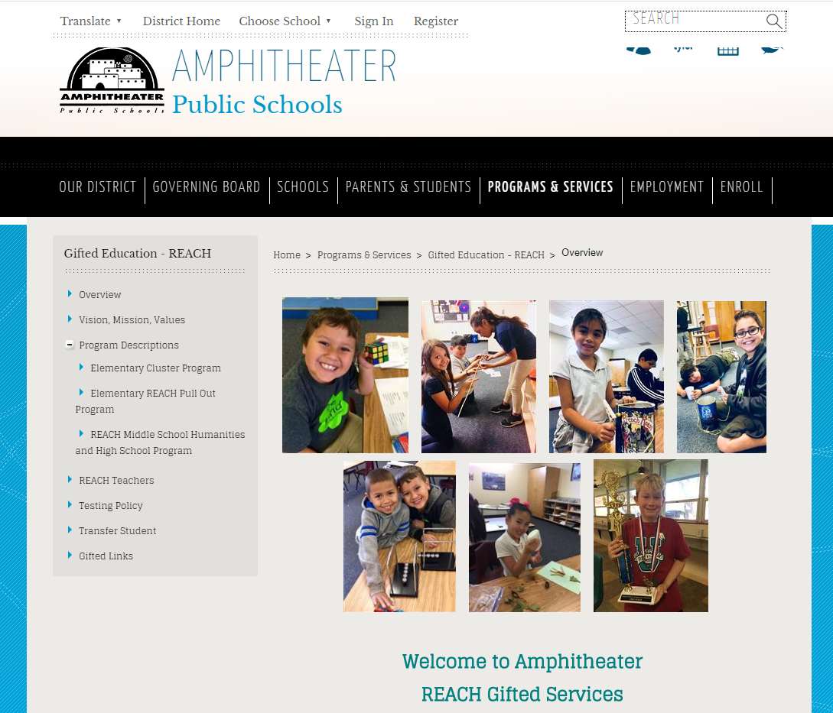

Amphitheater Schools
Community Leadership in Gifted Education
K-12 Alignment with National Standards
District REACH Page
District Home Page

Slide 30
Beyond the Classroom
“See me for who I really am. All of my beautiful parts.”
“Help me understand my exceptions.”
“Guide me to grow, learn and explore.”
“Remind me that perfection is not my goal. Encourage me to take risks.”
“Listen to me.”
Family support
Advocates, allies and mentors
Fine arts
STEM
STEAM
Languages
Humanities
JTED, CTE, Dual-Enrollment
Advanced Placement (AP)
AVID
IB Diploma
Honors Seminar and Capstone
Internships
Clubs
Community Service
Entrepreneurship
Odyssey of the Mind
Model United Nations
Coding
Sports
More Fine Arts
Summer programs

Slide 31
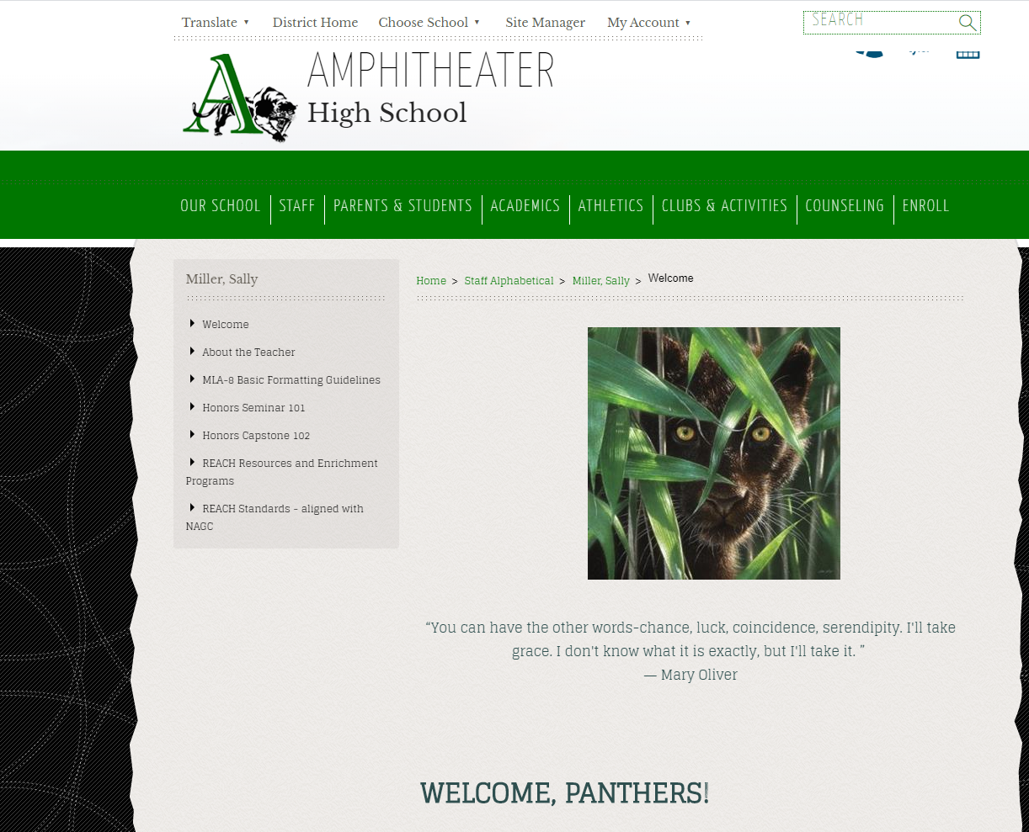
FIND YOUR REACH TEACHER

Slide 32

Not all who wander are lost …
…along the way,
we discover who we really are☺

